Slide 1
JavaScript Programming
HTML Basics

Slide 2
What is HTML?
HTML is the standard markup language for creating Web pages.
HTML stands for Hyper Text Markup Language
HTML describes the structure of Web pages using markup
HTML elements are the building blocks of HTML pages
HTML elements are represented by tags
HTML tags label pieces of content such as "heading", "paragraph", "table", and so on
Browsers do not display the HTML tags, but use them to render the content of the page

Slide 3
A Simple HTML Document
<!DOCTYPE html>
<html>
<head>
<title>Page Title</title>
</head>
<body>
<h1>My First Heading</h1>
<p>My first paragraph.</p>
</body>
</html>

Slide 4
A Simple HTML Document (explanation)
The <!DOCTYPE html> declaration defines this document to be HTML5
The <html> element is the root element of an HTML page
The <head> element contains meta information about the document
The <title> element specifies a title for the document
The <body> element contains the visible page content
The <h1> element defines a large heading
The <p> element defines a paragraph

Slide 5
HTML Tags
HTML tags are element names surrounded by angle brackets: <tagname>content goes here...</tagname> HTML tags normally come in pairs like <p> and </p> The first tag in a pair is the start tag, the second tag is the end tag The end tag is written like the start tag, but with a forward slash inserted before the tag name
Tip: The start tag is also called the opening tag, and the end tag the closing tag.

Slide 6
HTML Headings
HTML headings are defined with the <h1> to <h6> tags. <h1> defines the most important heading. <h6> defines the least important heading: Example: <h1>This is heading 1</h1> <h2>This is heading 2</h2> <h3>This is heading 3</h3>

Slide 7
HTML Paragraphs
HTML paragraphs are defined with the <p> tag: Example: <p>This is a paragraph.</p> <p>This is another paragraph.</p>

Slide 8
HTML Links
HTML links are defined with the <a> tag: Example: <a href="https://www.w3schools.com">This is a link</a> The link's destination is specified in the href attribute. Attributes are used to provide additional information about HTML elements.

Slide 9
HTML Images
HTML images are defined with the <img> tag. The source file (src), alternative text (alt), width, and height are provided as attributes: Example: <img src="vum.jpg" alt="VUM" width="200" height="100“ />

Slide 10
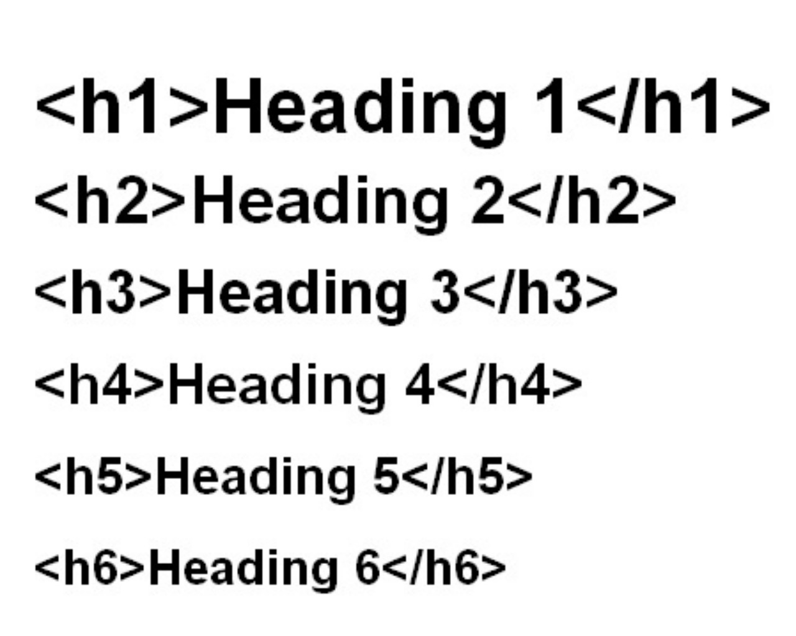
HTML Headings

Slide 11
Task 1:
Create an HTML page which contains: - Correct HTML structure (html, head, body) - Page title to be “My first HTML page” - 4 paragraphs of text - First paragraph to have a heading 1, second => heading 2, etc. - 2 images - as part of paragraphs 2 and 4

Slide 12
HTML Elements
An HTML element usually consists of a start tag and end tag, with the content inserted in between:
HTML elements can be nested (elements can contain elements)
Do Not Forget the End Tag
<p>content should be <p>content</p>
Empty HTML Elements
<br> should be <br/>
Use Lowercase Tags
<BR/> should be <br/>

Slide 13
HTML Attributes
All HTML elements can have attributes
Attributes provide additional information about an element
Attributes are always specified in the start tag
Attributes usually come in name/value pairs like: name="value"

Slide 14
Common HTML attributes
<a href="https://www.w3schools.com">This is a link</a>
<img src="img_girl.jpg">
<img src="img_girl.jpg" width="500" height="600">
<img src="img_girl.jpg" alt="Girl with a jacket">
<p class="paragraph_007">
<form action="/subscribe" method="POST">

Slide 15
HTML Text Formatting
<b> - Bold text <strong> - Important text <i> - Italic text <em> - Emphasized text <mark> - Marked text <small> - Small text <del> - Deleted text <ins> - Inserted text <sub> - Subscript text <sup> - Superscript text
It is recommended to use CSS for styling and formatting

Slide 16
HTML Comments
You can add comments to your HTML source by using the following syntax <!-- Write your comments here --> Comments are not displayed by the browser, but they can help document your HTML source code.
Example <!-- Do not display this at the moment <img border="0" src="pic_mountain.jpg" alt="Mountain"> -->

Slide 17
HTML Links - Hyperlinks (1)
HTML links are hyperlinks. You can click on a link and jump to another document or somewhere else in the current document. When you move the mouse over a link, the mouse arrow will turn into a little hand. A link does not have to be text. It can be an image or any other HTML element.

Slide 18
HTML Links - Hyperlinks (2)
Example - link to external resource (page): <a href="https://www.vum.com/" target="_blank">Visit VUM!</a> Example - image link: <a href="default.asp"> <img src="smiley.gif" alt="Alternative text" > </a> Example - link to bookmark inside the same page: Bookmark: <h2 id="C4">Chapter 4</h2> Link: <a href="#C4">Jump to Chapter 4</a> Link from another page to the same bookmark: <a href="html_demo.html#C4">Jump to Chapter 4</a>

Slide 19
Task 2:
Create 2 pages with mixed content - paragraphs and images.
Each page should be bigger than 1 screen as content.
Each page should have at least 3 links
Link at the top to the bottom of the page
Link at the bottom to the top of the page
Link to the middle element of another page
Hint: you can use the following page for generating content: https://www.lipsum.com/

Slide 20
HTML Images
Use the HTML <img> element to define an image Use the HTML src attribute to define the URL of the image Use the HTML alt attribute to define an alternate text for an image, if it cannot be displayed Use the HTML width and height attributes to define the size of the image Use the CSS width and height properties to define the size of the image (alternatively) Use the CSS float property to let the image float Use the HTML <map> element to define an image-map Use the HTML <area> element to define the clickable areas in the image-map Use the HTML <img>'s element usemap attribute to point to an image-map Use the HTML <picture> element to show different images for different devices
Examples: https://www.w3schools.com/html/html_images.asp

Slide 21
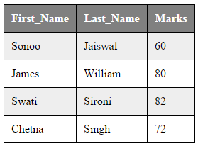
HTML Tables
<table> <tr> <th>First_Name</th> <th>Last_Name</th> <th>Marks</th> </tr> <tr> <td>Sonoo</td> <td>Jaiswal</td> <td>60</td> </tr> <tr> <td>James</td> <td>William</td> <td>80</td> </tr> </table>

Slide 22
HTML Tables
Use the HTML <table> element to define a table Use the HTML <tr> element to define a table row Use the HTML <td> element to define a table data Use the HTML <th> element to define a table heading Use the HTML <caption> element to define a table caption Use the CSS border property to define a border Use the CSS border-collapse property to collapse cell borders Use the CSS padding property to add padding to cells Use the CSS text-align property to align cell text Use the CSS border-spacing property to set the spacing between cells Use the colspan attribute to make a cell span many columns Use the rowspan attribute to make a cell span many rows Use the id attribute to uniquely define one table

Slide 23
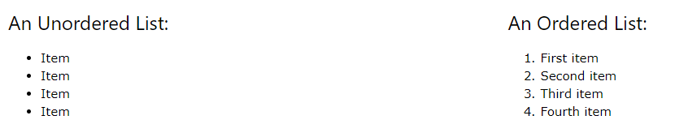
HTML Lists
<ul> <li>Item</li> <li>Item</li> <li>Item</li> </ul>
<ol> <li>First item</li> <li>Second item</li> <li>Third item</li> </ol>

Slide 24
HTML Lists
Use the HTML <ul> element to define an unordered list Use the CSS list-style-type property to define the list item marker Use the HTML <ol> element to define an ordered list Use the HTML type attribute to define the numbering type Use the HTML <li> element to define a list item Use the HTML <dl> element to define a description list Use the HTML <dt> element to define the description term Use the HTML <dd> element to describe the term in a description list Lists can be nested inside lists List items can contain other HTML elements Use the CSS property float:left or display:inline to display a list horizontally

Slide 25
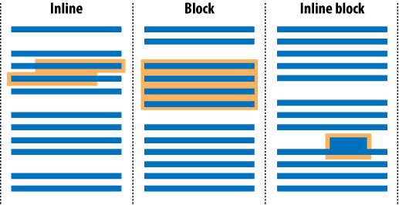
HTML Block and Inline Elements (1)

Slide 26
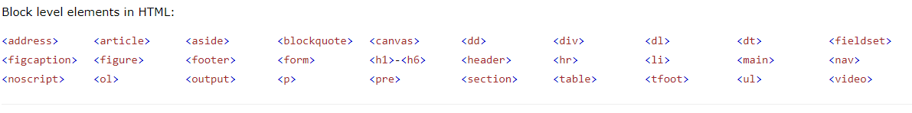
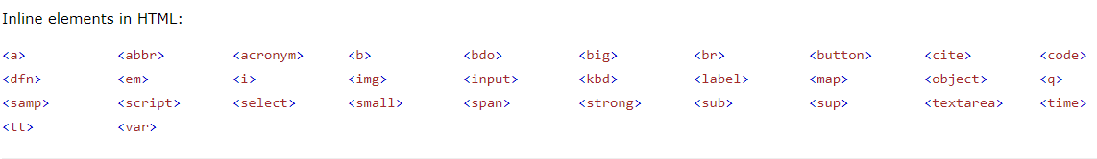
HTML Block and Inline Elements (2)

Slide 27
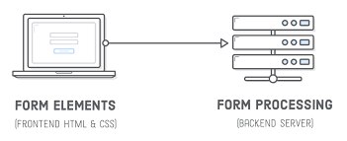
HTML Forms

Slide 28
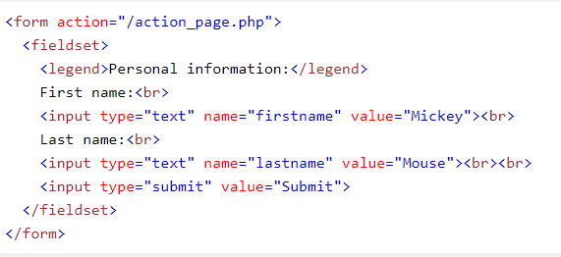
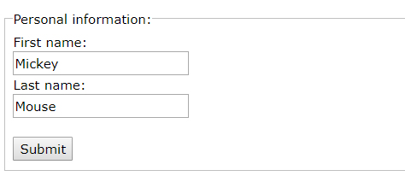
HTML Forms

Slide 29
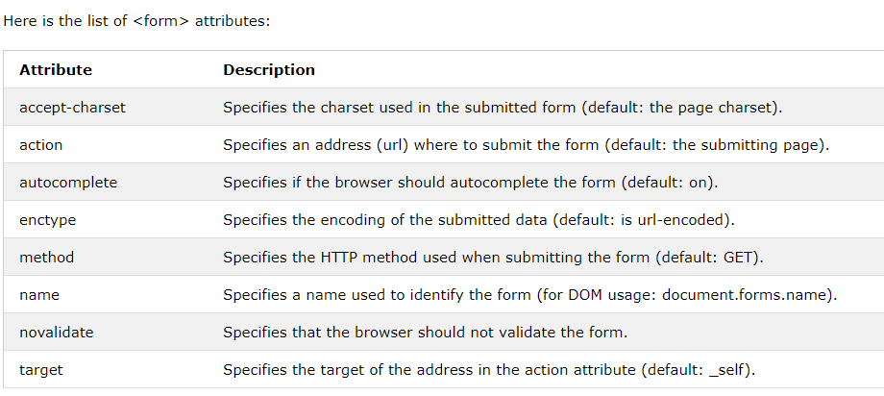
HTML Forms

Slide 30
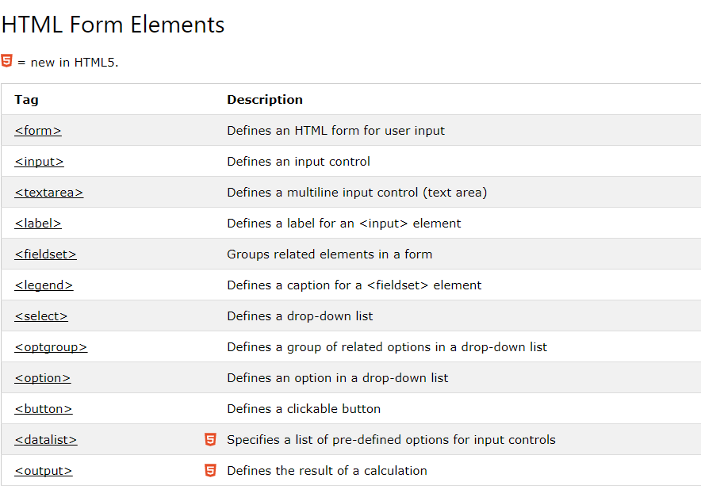
HTML Form Elements

Slide 31
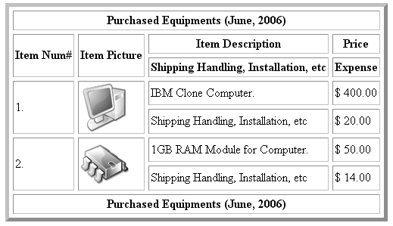
Task 3
Create HTML table similar to the one below:

Slide 32
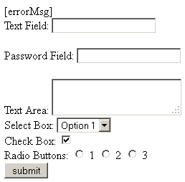
Task 4
Create a form similar to the one below:

Slide 33
Summary
HTML page structure
HTML Elements
HTML Attributes
HTML Elements behaviour - block and Inline
HTML Forms
HTML Tables

